Slide 1
Location Based Services for Mobiles: Technologies and Standards

Slide 2
Outline
Section I: Introduction
Historic overview
LBS concepts
LBS applications and market
Wireless Emergency System Mandates
LBS in cellular standards
Section II: Wireless Positioning Technologies
Basic positioning methods
Positioning Calculation
GPS and Galileo
Section III: Assisted GPS Architecture
Section IV: Implement Assisted GPS in Mobile Networks
LCS requirements
Location management in mobile networks
LCS architecture: control plane and user plane
LCS standards in mobile networks
Section V: Challenges for Mobile Location Services.
Regulations
Standardization
Market and Implementation

Slide 3


LBS: A Historic View
Emergency medical services (EMS)
In 1487, the first recorded use of ambulance was by the Spanish army, Queen Isabella of Spain.
Yellow pages (A more than $136B world wide market)
In 1886, Reuben H. Donnelly produced the first Yellow Pages.
In 1909, St. Louis produced the first Yellow Pages directory with coupons.
Local weather and traffic broadcast in radio and TV
Since 1960s, radio traffic report has been very popular in US.
On May 2, 1982, the weather channel (TWC) went on the air.
Emergency phone services
In 1968, AT&T and FCC come out with this nationwide emergency phone number – 911. (It is 1-1-2 across the European Union and 999 in UK).
In 2000, FCC issued a mandate of E911 to wireless carriers.
Notes:
When we are going to talk about LBS, many people think it is a generation-X term.
Some people may think it is so new or futuristic and usually exists in some Sci-Fi styled movies.
In fact, as you can see on this slide, we have been enjoying LBS for so many years, since more than 500 years ago.
In the fifteen century, Spanish army uses EMS, one of the typical LBS, for helping injured soldiers. And it actually worked very well.
Since 1880s, we have yellow pages, which turned out to be a huge success and have a $136B world-wide market. Now almost every household has at least one copy of it. And there are three copies delivered to my house very year.
Also in our daily work life, there is traffic radio and weather broadcast helping you being prepared.
When you have some emergency, you know what to do. Dial 9-1-1.
The amazing part of 9-1-1 and later E911 is, it not only provides you the emergent help, but also tries to deliver the help to you in the right place as soon as possible.
And this is possible only because it combines emergent service and LBS togather.

Slide 4

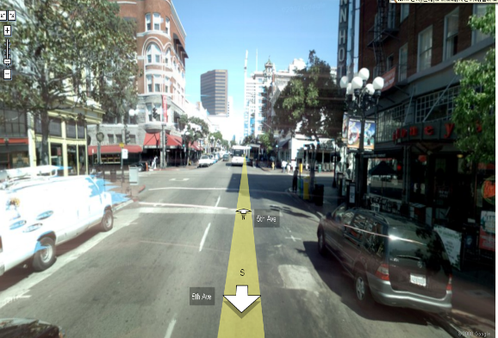
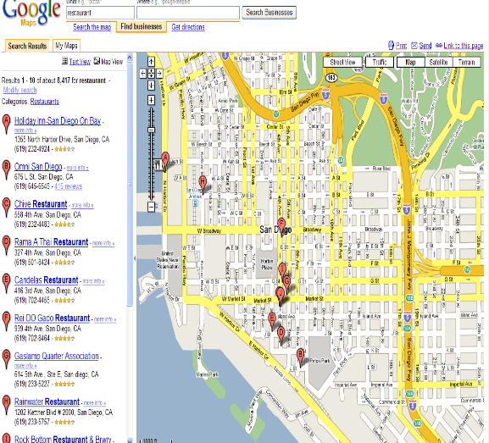
Basic Concepts of LBS
Position
“32° 49' 49.7964"-116° 49' 9.9228"”
Position appears to developers in the form of spatial coordinates.
It can be represented as a single point in the coordinate.
Location
“San Diego downtown gas lamp quarter”
Location is associated with a certain place in the real world.
If positioning delivers a spatial location, it will be mapped onto a descriptive location in order to be interpretable by the LBS user.
LoCation Service (LCS)
“Where am I?”
LCS should be distinguished from LBS as it exclusively deals with the localization of target, and also makes the resulting location data available to external actors.
It is responsible for the generation and delivery of location data.
Location Based Service (LBS)
“How can I go to the gas lamp quarter from here?”
LBS is the service that adds value to target locations provided by LCS. It uses knowledge of a mobile device’s location to offer value to the mobile subscriber or to a third party.
Notes:
We talk about LBS a lot recently, especially with the advance of mobile phone technologies. However, what exactly does LBS mean in our conversations?
In the LBS used by most people, there are four basic concepts in it.
Position is the concept, which is defined for machine or for computer to read and understand and handle.
For example, at latitude 32 degree north and longitude 116 degrees east
Location is the concept, which is for people to associate with a certain place in the real world.
The gas lamp quarter in San Diego downtown, which is correspond to the position, latitude 32 degree north and longitude 116 degrees east
Location Service, (LCS) is the process or service which help connect a position and a location.
Where am I?
LBS is the services which adds more value to the services provided by LCS.
How can I get to the gas lamp quarter from my current position?

Slide 5
LBS and A-GPS
LBS is gaining increasing popularity in mobile users. It should be included as a important feature of next generation mobile standards.
GPS-based positioning is known to be one of the most reliable positioning schemes with the best coverage and highest accuracy.
“With close to 1.18 billion mobile handsets sold in 2007 and an expected 1.8 billion in 2012, close to 30% of existing worldwide mobiles are GPS-capable in 2008. This number is increasing every year and predicted to more than 35% in 2012” -- Texas Instrument and gpsWorld.
“Global revenue from location-based services will hit $13.3 billion by 2013, compared with $515 million in 2007.” -- ABI Research

Slide 6
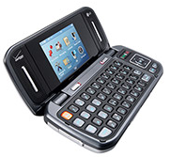
LBS Applications
Emergency Services
E-911
Roadside Assistance
Tracking
Commercial: workforce, fleet management
Family locator
Personal asset tracking
Navigation
Direction
Planning
Assistance
Billing
Road tolling
parking
LBS Alert
Promotion alert
advertising
Social Networking
Friend-finder
Instant messaging.
Network Operator Applications
Location sensitive billing
Cellular fraudulent detection and prevention
Wireless network optimization
Cellular inter-network border negotiation.
Service Provider Application
Fleet navigation and management
Wireless M2M
Remote access/management – mobile data/television
Auto insurance
Promotion and advertising
End-User Application
Tons of it.
Notes:
There are tons of available and imaginable LBS Applications. Here is a short list of them
There are many different ways to categorize these services and look at them in different perspectives. And this can help us understand LBS before start your own LBS project.
The left side is a traditional way to divide LBS applications. The right side is more from a LBS client perspective.
As we will mention this later, to understand LBS from a client perspective is one of the key factors to insure the success of LBS.

Slide 7
LBS Services in Market
Notes:
Here are three typical examples of LBS application in the market.
One of the reasons I put them together on this slide, I want to show you that when we design LBS, it is very important to ask ourselves several questions
Which customer segment it targets to?
Is it easy to use?
How does it add additional values to the clients, compared with other solutions if available?
Does it meet the privacy and security concerns of the customers or not?

Slide 8




















LBS Companies
Chipset
Providers
Software
Providers
System
Providers
Service
Providers
Notes:
We have so many LBS applications. This also means we have lots LBS companies.
Here is a short list. And I guess most of them you are already familiar with.
Here what I did is to make a segmentation on these companies and position them different in the LBS food chain.
I guess one thing I need mentioned is, some companies may work on more than one segment of LBS.
Then, if you want to start a LBS project, it will be easy for you to understand who is your competitor and who will be your partner.

Slide 9
Major Design Challenges
Positioning technologies
Different levels of accuracy required for various services
Multiple mobile positioning techniques with varying accuracy
Quality of position: horizontal accuracy, response time, etc.
Privacy
“Right to be let alone”
Users care about their privacy and are concerned with any intrusions.
Dilemma: LBS may be highly beneficial while it can do harm to the user’s privacy.
Interoperability
Key for LBS to expand from a niche service to a mass market service
Standards help LBS providers deliver products and services while reducing cost and business risks.
Emergency services
Timely delivery of accurate emergency call locations to the close emergency station
Demanding emergency service mandates in the US and the EU
Notes:
Now after you understand the LBS market and some success factors, before starting your LBS project, I think there will be another question in your mind. What kind of challenges I will face in my future LBS project.
Actually different LBS projects may have their own major challenges. Here we combined those major design challenges met by previous LBS designed for your considerations.

Slide 10
Key Factors to LBS Success
Compelling applications
Valuable to consumers or businesses
Easy and intuitive to use
Good return on the investment.
Handset availability
Wide range of LBS-capable handsets
Internet-friendly
IP-based user plane standards.
Good business model
Customer segmentation is important
Adopt applications from 3rd parties.
Help operators increase revenue.
User awareness and promotion
Security and privacy concerns
Notes:
Here is a list of several key factors we believe to be critical to the success of your LBS project. And some of them we mentioned in the previous slides.

Slide 11
The US Wireless Enhanced 911
The FCC Wireless Enhanced 911
Phase I: Within six months after a request by a PSAP, the carrier shall provide the telephone number and the cell site location for this 911 call.
Phase II: Within six months of a request by a PSAP, more precise location information, such as the latitude and longitude of the caller, shall be provided.
Network-based solutions, 100 meters for 67%; 300 meters for 95%.
Handset-assisted solutions, 50 meters for 67%; 150 meters for 95%.
By September 11, 2012, even more precise location information shall be provided. It requires wireless operators to average their compliance over each local region instead.
The DOT NG 911 Initiative
The NG 911 Initiative is a R&D project to help establish a digital, IP-based foundation for the delivery of multimedia 911 "calls.“
The NG 911 initiative will establish the foundation for public emergency communications services in a wireless mobile society.
Notes:
When we talk about LBS, we really need talk about FCC E911 and standardization issues. In the following two slides we are going to address them individually.
For Phase I,
tile April 1998. In it, the carriers shall must cell site, sector and call-back number for 911 calls.
For Phase II,
tile 2002, the carriers must ensure that at least 95% of all new digital handsets activated are ALI-capable.
Within 2 years or by Dec. 31st, 2004, whichever is later, from a PSAP request is received and undertake reasonable efforts to achieve 100% penetration of ALI-capable handsets in its total subscriber base.

Slide 12



LBS Standardization
3GPP and 3GPP2 (3rd Generation Partnership Project)
Telecommunication industry collaborations to make 3G mobile phone system specifications within the scope of ITU.
Interest in positioning technologies in cellular networks and related location services.
OMA (Open Mobile Alliance)
A standards organization for delivering open technical specifications for application level and service frameworks.
Provide protocols and interfaces that enable the exchange of location data between different networks.
IETF (Internet Engineering Task Force)
An open standards organization develops and promotes Internet standards.
Specify protocols for integrating location data with Internet or Web-based applications.

Slide 13
Acronyms
3G – The Third Generation
3GPP – The 3rd Generation Partnership Project
3GPP2 – The 3rd Generation Partnership Project 2
ALI – Automatic Location Identification
CDMA – Code Division Multiple Access
CGALIES - the Coordination Group on Access to Location Information for Emergency Services
EMS – Emergency Medical Services
EMTEL – Emergency Telecommunications
ETSI – The European Telecommunications Standards Institute
GSMA – The GSM Association
GPS – Global Positioning System
IETF – Internet Engineering Task Force
LBS – Location Based Services
LCS – Location Services
LORAN – Long Range Navigation
NGN – Next-Generation Network
OCG – Operational Co-ordination Group
OMA – Open Mobile Alliance
PSAP – Position Service Access Point
TWC – The Weather Channel
UMTS – Universal Mobile Telecommunications System
UTRAN -- UMTS Terrestrial Radio Access Network

